Slide 1



4 × 4 Circularly Polarized Microstrip Patch Antenna Array
Guided by:
Mr. K. Sudhakar, B.E.,M.E.,
Assistant professor / ECE
Team members:
Harshita.B -927622BEC072
Indumathi.R -927622BEC075
Infant Bena.B -927622BEC076
Janani.B.C -927622BEC081
Meha.T -927622BEC119

Slide 2
Objective
The antenna array should meet the following performance criteria:
Bandwidth: Achieve a bandwidth of at least 600 MHz around the center frequency.
Axial Ratio: Ensure the axial ratio is less than 3 dBi across the entire bandwidth to maintain circular
polarization, specifically Right-Hand Circular Polarization (RHCP).
Gain: Provide a gain of at least 12 dBi across the entire bandwidth.
Return Loss: Ensure the return loss is greater than 10 dB, corresponding to a voltage standing wave ratio (VSWR) of less than 2:1, indicating minimal signal reflection.
Radiation Pattern: The design should optimize beam width and minimize side lobes to ensure good
directional characteristics.

Slide 3
Literature Review
YEAR | TITLE OF PAPER | DESCRIPTION | PUBLISHER
2019 | Bandwidth Enhancement of Low-Profile Metasurface Antenna Using Nonuniform Geometries | Explores how nonuniform geometries in metasurface antennas improve bandwidth while maintaining a low-profile design. This approach enhances impedance matching and supports higher-order modes. | IEEE (https://ieeexplore.ieee.org/document/8756166)
2023 | Bandwidth Enhancement of Low-Profile Metasurface Antenna Using Nonuniform Geometries | Presents a metasurface antenna design with nonuniform geometries that improves bandwidth and maintains a compact profile. | IEEE (https://ieeexplore.ieee.org/document/10146462)
18ECP107L- PROJECT WORK - END SEMESTER REVIEW PRESENTATION

Slide 4
YEAR | TITLE OF PAPER | DESCRIPTION | PUBLISHER
2021 | A Gain-Enhanced Patch Antenna With a Periodic Microstrip Rampart Line | The paper proposes a patch antenna design with a periodic microstrip rampart line to enhance gain and improve radiation efficiency. | IEEE (https://ieeexplore.ieee.org/document/9650511)
2018 | Microstrip Patch Antennas With Multiple Parasitic Patches and Shorting Vias for Bandwidth Enhancement | The paper presents a microstrip patch antenna design with multiple parasitic patches and shorting vias to enhance bandwidth and improve overall antenna performance. | IEEE (https://ieeexplore.ieee.org/document/8263171)
18ECP107L- PROJECT WORK - END SEMESTER REVIEW PRESENTATION

Slide 5
Abstract
This document gives the design and evaluation of a 4 × 4 circularly polarized microstrip patch antenna array, specifically designed for a central frequency of 8.25 GHz. The design implies an FR4 substrate, recognized for its affordability, which facilitates a broad bandwidth more than 600 MHz, thereby supporting high data rates in communication systems. The axial ratio is consistently maintained below 3 dB throughout the entire bandwidth, demonstrating strong circular polarization capabilities. Additionally, the design achieves a gain of 12 dBi or greater, ensuring dependable signal strength and coverage. Essential performance indicators, such as a return loss greater than 10 dB and a voltage standing wave ratio (VSWR) below 2, are attained, indicating superior impedance matching. The antenna's right-hand circular polarization (RHCP) renders it suitable for applications in satellite communication, radar, and other fields where polarization integrity is essential. Extensive simulations and analyses conducted using ANSYS HFSS substantiate the design, offering valuable insights into how substrate characteristics and design parameters affect overall performance.

Slide 6
Comparison between 4X1 array and 4X4 array
S.NO | FACTORS | 4 x 1 ARRAY | 4 x 4 ARRAY
1 | Array configuration | It consists of 4 patch elements | It consists of 16 patch elements
2 | Gain | Since the array has fewer elements the gain will be moderate compared to larger arrays. The gain increases with the number of elements | Since the array has more elements the gain will be large. The beam will be narrow in both horizontal and vertical plane offering more directivity
3 | Bandwidth | Smaller array offers a narrow bandwidth. | It offers a wider bandwidth due to the large number of elements
4 | Radiation pattern | The radiation pattern of the 4 x 1 array will have a wider bandwidth in one direction. Relatively narrow beam in azimuth plane | 4 x 4 array will produce a much more directional radiation pattern. Relatively narrow beamwidth in both the azimuth and the elevation planes.

Slide 7
Comparison between 4X1 array and 4X4 array
S.NO | FACTORS | 4 x 1 ARRAY | 4 x 4 ARRAY
5 | Antenna efficiency | The efficiency can be lower than 4 x 4 array because of fewer elements contribute to the overall performance. | Efficiency is higher due to better combination of signals from multiple elements.
6 | Polarization | Polarization purity may be lower due to fewer patch elements. | Polarization can be more uniform and stable providing better purity.
7 | Complexity | Easier to design and manufacture due to smaller number of elements | More complex design and feed network is required.
8 | Size | Physically smaller making it suitable for applications where spaces is constraint. | Large in size due to increased number of patch elements.

Slide 8
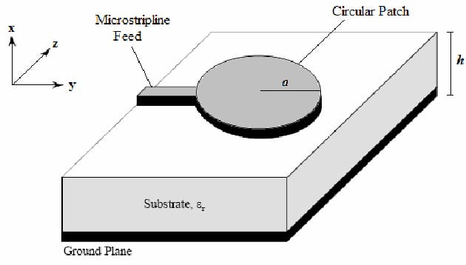
Block diagram

Slide 9
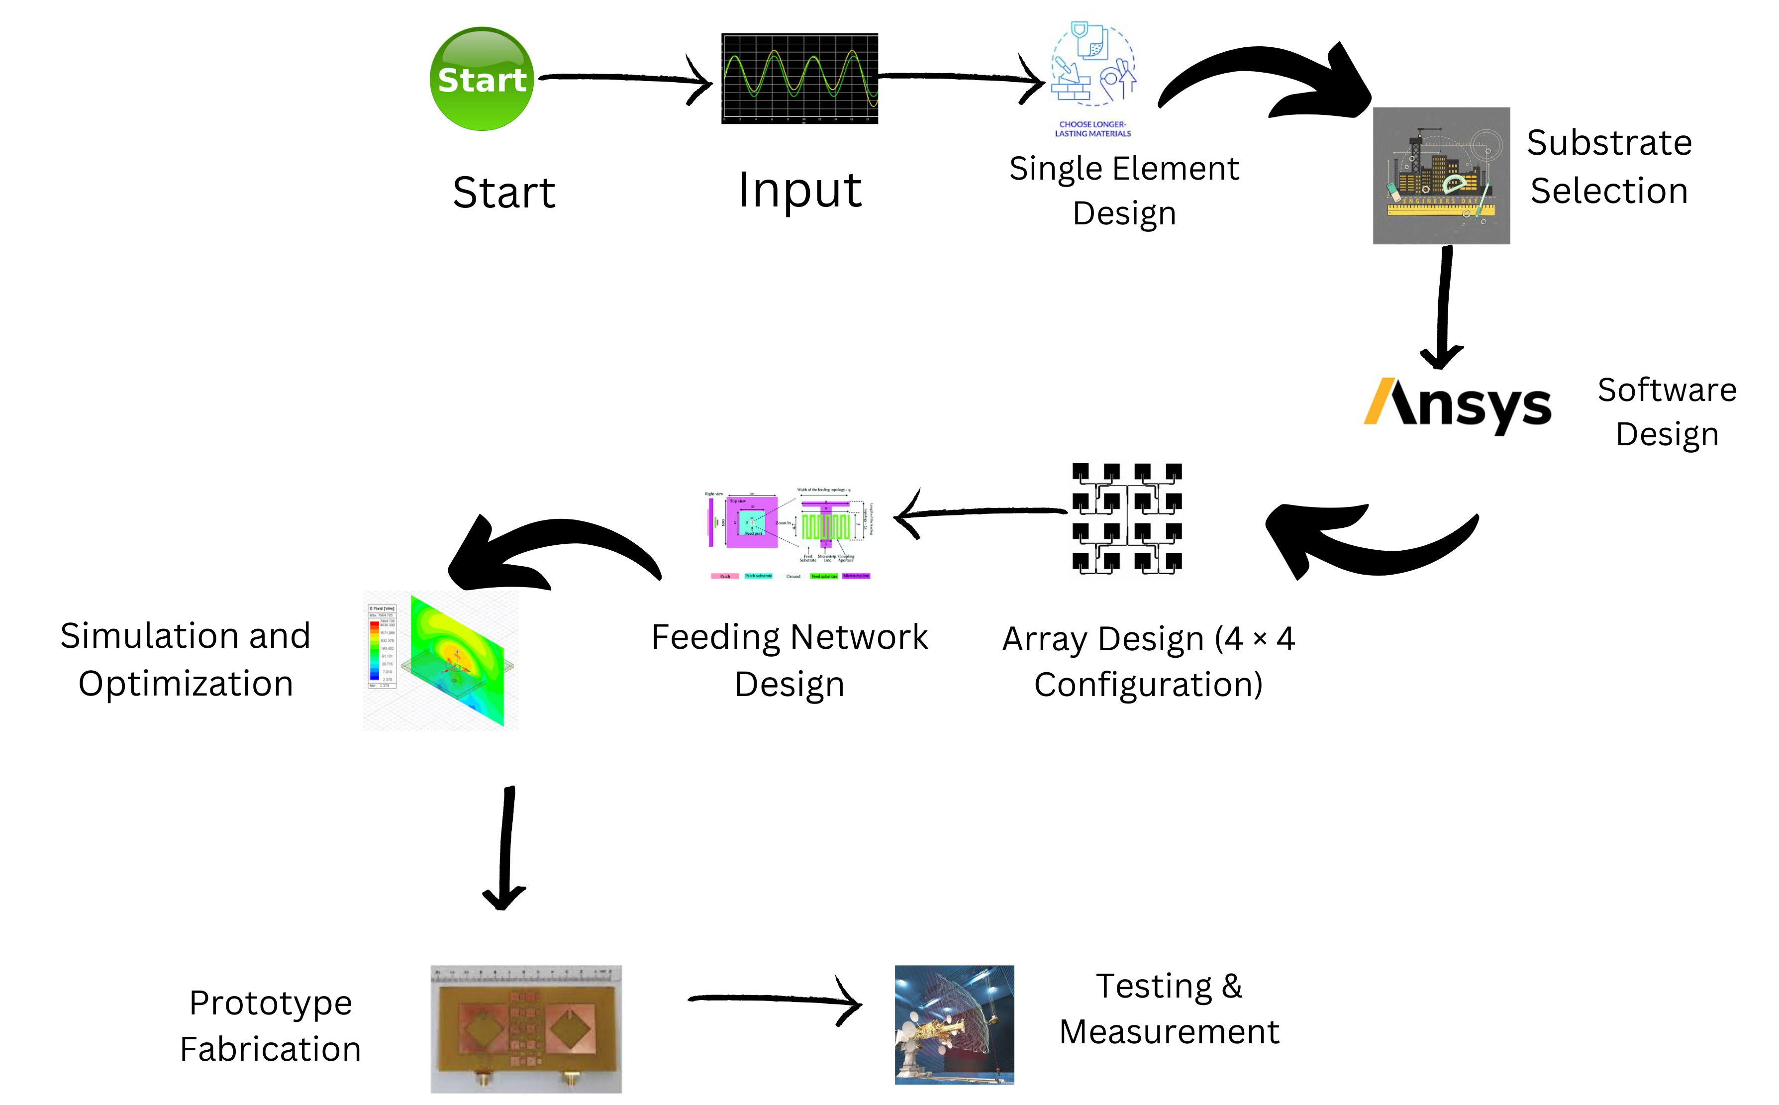
Working Plan

Slide 10
Reference
BOOK REFERENCE:
Balanis, Constantine A. Antenna Theory: Analysis and Design. John Wiley & Sons, 2016.
ONLINE RESOURCES:
IEEE Xplore Digital Library (https://ieeexplore.ieee.org/): Contains a vast number of papers on microstrip patch antennas and circular polarization.
SOFTWARE REFERENCE:
ANSYS HFSS (https://www.ansys.com/products/electronics/ansys-hfss): Another industry-standard software for antenna design and analysis.

